Slide 1

Impact of Academic-Life balance on mental health
Presentation by:
Srushti kalambe
Rafiq kondker
Darshit Dasadia

Slide 2



INDEX
01 - Introduction
02 - Aim
03 - Visualisation
04 - Tests performed
05 - Conclusions

Slide 3

01 - INTRODUCTION
The focus of this analysis is to explore and understand the factors that impact student’s academic experiences, mental health, time management, and support-seeking behavior.
The data for this study was collected through a survey aimed at identifying patterns and relationships between key variables such as academic workload pressure, time management, college support, and student demographics (e.g., gender, age, and qualification level).

Slide 4

"We need to understand what happens to us inside"
02 - AIM
The aim of this analysis is to delve into how students' academic lives, particularly the pressures they face, are influenced by their ability to manage time, seek support, and balance their mental well-being.
By applying statistical tests such as T-tests, Z-tests, F-tests, ANOVA, correlation, regression, and chi-square tests, we aim to uncover significant differences, correlations, and predictive relationships between these factors.

Slide 5

DATA CLEANING
In this data analysis project, the cleaning process involved several key steps to prepare the data for statistical tests and deeper insights.
Removal of Unnecessary Columns
Removed a timestamp column early in the cleaning process to declutter the dataset and focus on meaningful variables.
Handling Missing Data
Data contained some missing values, we replaced missing values with a default value, ‘Not Answered’.
Standardization of Data Types
To ensure the dataset was structured correctly for analysis, columns containing categorical data were converted to appropriate formats.
Dealing with Outliers and Inconsistent Data
Although outliers were minimal in this dataset, basic checks were conducted to ensure that all values fell within expected ranges.

Slide 6

02 - DATA VISUALISATION
Data visualization is a powerful tool that enables researchers to communicate insights derived from data analysis effectively.
Bar Charts:
Used to compare categorical data, such as the distribution of gender among respondents or the number of students reporting various levels of support-seeking behavior.
Pie Charts:
Employed to illustrate the proportions of different demographic groups (e.g., gender distribution) within the dataset.
Box Plots:
Used to show the distribution of numerical variables, such as academic workload pressure or time management effectiveness, across different demographic groups.
Heatmaps:
Used to represent the correlation matrix between numerical variables, visually indicating the strength and direction of relationships.

Slide 7
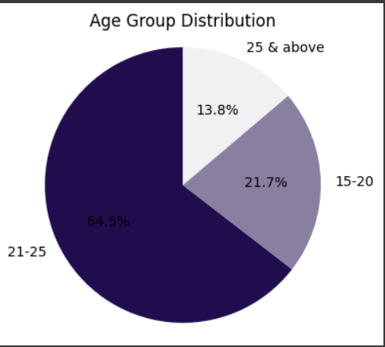
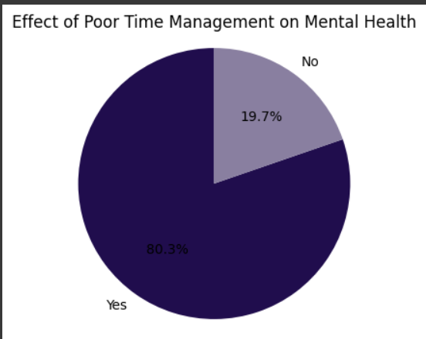
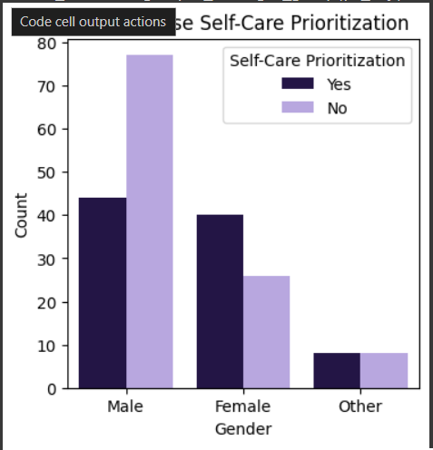
pie chart
pie chart
Bar graph

Slide 8
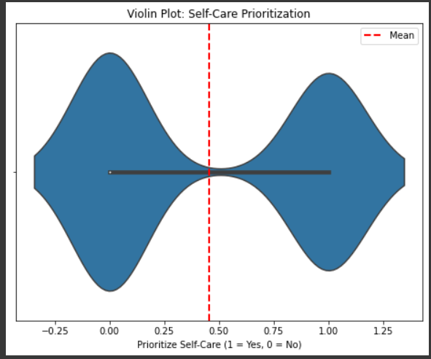
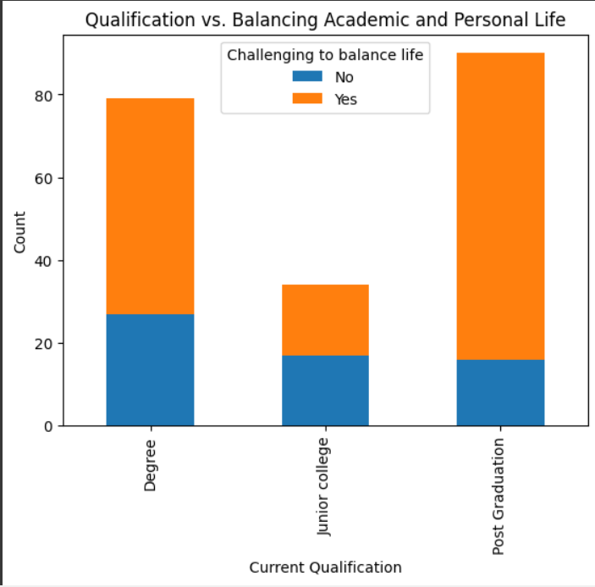
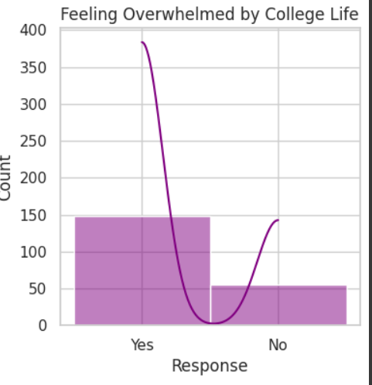
histogram
Violin plot
barplot

Slide 9
04 - TEST PERFORMED
T-test: Gender vs Feeling pressured by academic workload
Null Hypothesis (H₀): There is no difference between males and females in how pressured they feel by academic workload.
Alternative Hypothesis (H₁): There is a significant difference between males and females in how pressured they feel by academic workload.
p-value: 0.323
A p-value greater than 0.05 indicates that we fail to reject the null hypothesis.
This means that there is no statistically significant difference between males and females in feeling pressured by academic workload.
Chi-Square test:Gender vs. Challenging to balance academic & personal life
Null Hypothesis (H₀): Gender and the challenge of balancing academic and personal life are independent (i.e., there is no association between them).
Alternative Hypothesis (H₁): There is a significant association between gender and the challenge of balancing academic and personal life.
p-value: 0.0022
A p-value lower than 0.05 suggests that the null hypothesis can be rejected.
This means there is strong evidence that gender and the challenge of balancing academic and personal life are related

Slide 10
ANOVA : Age Groups vs. Feeling pressured by academic workload
ANOVA is used when comparing the means of more than two groups. In this case, it’s being used to see if there is a significant difference in how different age groups (e.g., 15-20, 21-25, 25 and above) feel about academic workload pressure.
Null Hypothesis (H₀): There is no difference in feeling pressured by academic workload among the different age groups.
Alternative Hypothesis (H₁): At least one age group differs significantly in how pressured they feel by academic workload.
p-value :0.0024
A p-value less than 0.05 indicates that we reject the null hypothesis.
This means that there is a significant difference in academic workload pressure across the different age groups.

Slide 11

Conclusion:
This analysis provides valuable insights into the relationship between gender, age, academic pressure, and the challenges students face in balancing academic and personal life.
Gender influences the challenges of balancing academic and personal life, and addressing these differences can help create more inclusive support systems.
Age-related differences in academic pressure call for targeted stress management programs that cater to specific age groups.
Universities should implement support systems that address both gender and age-specific needs.
This comprehensive analysis provides a clear direction for improving student well-being and academic success through targeted interventions that consider both age and gender factors. Institutions should adopt data-driven strategies to enhance the overall student experience.
specific age groups.
Conclusion:
This analysis provides valuable insights into the relationship between gender, age, academic pressure, and the challenges students face in balancing academic and personal life.
Gender influences the challenges of balancing academic and personal life, and addressing these differences can help create more inclusive support systems.
Age-related differences in academic pressure call for targeted stress management programs that cater to specific age groups.
Universities should implement support systems that address both gender and age-specific needs.
This comprehensive analysis provides a clear direction for improving student well-being and academic success through targeted interventions that consider both age and gender factors. Institutions should adopt data-driven strategies to enhance the overall student experience.
specific age groups.

Slide 12

Thanks
Srushti kalambe
Rafiq kondker
Darshit Dasadia

